Slide 1
HEALING – The END
Prof. Ahmed Al-Salaymeh
University of Jordan
July 13th 2023

Slide 2
Tasks of WP 1
Task 1.1: In-depth Survey on State of art of Art Therapy in Education.
Task 1.2: In-depth Survey on Teachers and Students Competences and awareness.
Task 1.3: In-depth Survey on available facilities and resources
Task 1.4: Analysis of surveys’ results and elaboration of final Reports

Slide 3
Progress
No.​ | Task​ | Responsibility​ | Due Date​ | Status ​
1. ​ | Set a detailed plan​ | UCLL​ | M2​ | Done ​
2.​ | Prepare the first drafts of the three surveys​ | UCLL​ | M2​ | Done​
3. ​ | Review the surveys by the quality committee and send comments​ | Quality Committee​ | M3​ | Done​ ​
4. ​ | The responses will be collected ​ | JO partners​ TU partners​ | M3-M5​ | Done​ ​
5. ​ | The surveys will be analyzed, and the final report including the three surveys analysis will be prepared ​ | UCLL​ INU​ US​ | M6-M7​ | Done​ ​
6.​ | Progress report to be provided by WP leader every 6 months based on collected feedback from Co-Leaders​ | UCLL​ INU​ US​ | M6, M12​ | Done​

Slide 4
Filling Gaps – WP1
No. | Task | Responsibility | Due Date
1. | Scientific Paper (2nd paper)​ | UCLL​, UJ, IU | Still Under preparing

Slide 5
Tasks of WP2
Task 2.1: Definitions and Selection of Courses to be updated.
Task 2.2: Design of new courses and restructuring of existing courses.
Task 2.3: National Workshop on Curricula Development in Jordan and Tunisia
Task 2.4: Implementation & Accreditation of the courses into Curricula.

Slide 6
Progress
No. | Task | Responsibility | Due Date | Status
1 | The diploma will be interdisciplinary, that requires coordination between different faculties | JO Partners TU partners | During Project | Study plans are prepared
2 | The list of suggested courses will be prepared based on WP1 results | UNIBS IU UNIVGB | M8 | All courses are listed
3 | WP leader will prepare a course outline template with learning outcomes and ECTS component according to Bologna requirements | UNIBS | M9 | Done by UJ team and Wp5 Leader

Slide 7
Progress
No. | Task | Responsibility | Due Date | Status
4 | Creation of committees responsible to develop the selected courses | UNIBS IU UNIVGB | M10 | 31 subgroups were created
5 | Courses are fully developed as e-courses | Courses Committees | M15 | Done
6 | New Programme is fully accredited (Diploma/Master) | JO Partners TU partners | M18 | UJ – Accredited IU – Accredited INU – Accredited JUST – Accredited (need 2nd batch letter) HU – Accredited US – Accredited USFAX – Accredited UNIVGB – Accredited
7 | Piloting phase | JO Partners TU partners | M20-M36 | Done and Ongoing
8 | Progress report to be provided by WP leader every 6 months based on collected feedback from Co-Leaders | UNIBS IU UNIVGB | M12, M18, M24, M30, M36 | 6 reports are received

Slide 8
Progress
No. | Task | Responsibility | Due Date | Status
4 | Technical Check – 2nd Round | Technical Committee for Clusters | May, June, July | All cluster have been evaluated
5 | National WS for Stakeholders – JO Partners | JO Partners | May | Done
7 | National WS for Stakeholders – TU Partners | TU partners | May | Done
8 | Progress report to be provided by WP leader every 6 months based on collected feedback from Co-Leaders | UNIBS IU UNIVGB | M12, M18, M24, M30, M36 | 6 reports are received

Slide 9
Status of Clusters

Slide 10
Status of Clusters

Slide 11
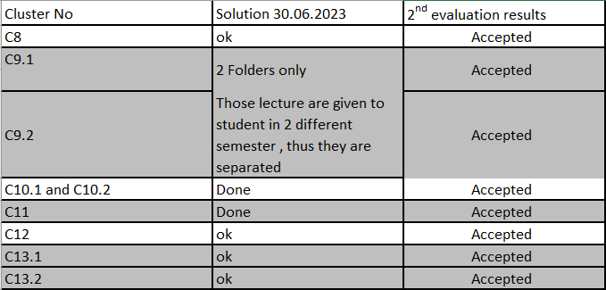
Status of Clusters

Slide 12
Status of Clusters

Slide 13
Filling Gaps – WP2
No. | Task | Responsibility | Due Date
1 | Vocational Diploma Accreditation letter for the 2nd batch | JUST
2 | Completing all post questionnaires for the second semester 2020-2023 Completing prequestionnaire for summer semester | All
3 | Commitment letters – existing course (missed) | JUST, UNIVGB

Slide 14
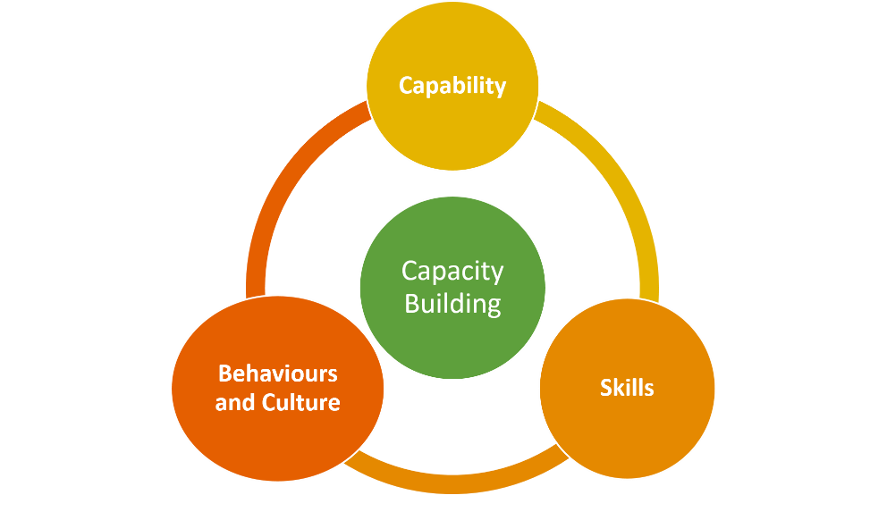
WP 3: Capacity Building and Training Workshops
Work package (3): Development
Duration: M12 to M36
Lead University: Universidade Católica Portuguesa UCP
Co-Lead University: Hashemite University & University of Sfax
Description:
Aims at developing human capacities and upgrading skills and capacities of university professors, technical assistants and students

Slide 15
Tasks of WP 3
Task 3.1: Elaboration of Capacity Building Plan & Selection Criteria.
Task 3.2: Academic and Technician Visits to EU Partners
Task 3.3: Students Visits to EU Partners.
Task 3.4: Academic workshops for transferring know-how and skills

Slide 16
Action Plan
No. | Task | Responsibility | Due Date | Status
1 | Preparing the capacity building plan including the aims, the training timetable and destinations, the suggested agenda, and the selection criteria for staff and students communicate with European partner. | UCP | M7 | In process
2 | (5) Training workshops in 5 EU countries for (32) Teaching staff & (16) technicians | EU Partners | M7-M20 | 5 are done
3 | (1 or 2) Training workshop for in 1 or 2 EU countries (16) students in Europe | EU Partners | M24-M30 | 3 are done
4 | (8) Technology-enhanced (In-house) teacher training (600) staff trained | JO Partners TU partners | M20-M36 | In progress (After Greece WS)
6 | Each workshop will be documented through a well-prepared report includes (List of participants, agenda, description of activities, link of training material, results of evaluation surveys, and photos) | Hosting University | After workshop | In Progress , NKUA
7 | Progress report to be provided by WP leader every 6 months based on collected feedback from Co-Leaders | UCP HU USFAX | M12, M18, M24, M30, M36 | 6 completed 1 remaining

Slide 17
Filling Gaps – WP3
No. | Task | Responsibility | Due Date
1. | Checking Implementation reports (UNIOS, UCLL, NKUA) | UCP
2. | Check Training Reports (EU visits) NKUA | UCP, NKUA
3. | Finalize the list of activities during the lifetime of the project | UCP, Rasha

Slide 18
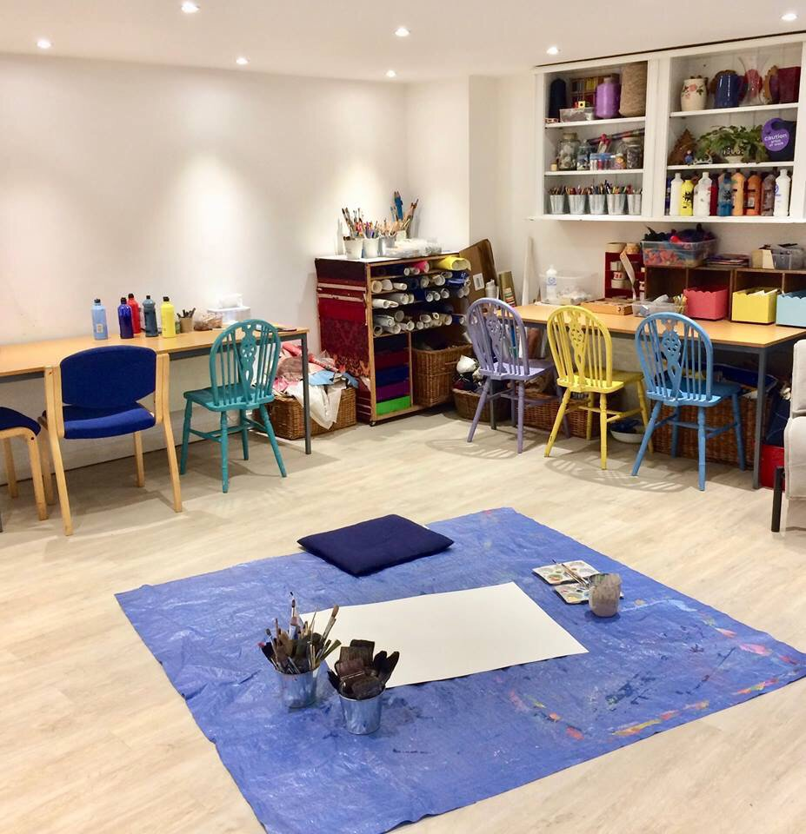
WP 4: Development of the Art Therapy Centre
Work package (4): Development
Duration: M12 to M24
Lead University: Porto Polytechnic
Co-Lead University: University of Sousse & The University of Jordan
Description:
The well equipped center will work on two tracks:
Offering a Professional Diploma in Art Therapy.
Providing clinical therapeutic services to all the different populations who are in need of support.

Slide 19
Tasks of WP 4
Task 4.1: Final List of Equipment
Task 4.2: Purchase, installation of equipment and Lab operation

Slide 20
Progress
No. | Task | Responsibility | Due Date | Status
1 | WP leader will set a detailed plan for the WP | IPP | M7 | Done
2 | Prepare a list of main components in Art therapy centers according to EU standards | IPP | M7 | Done
3 | WP leader and co-leaders will set the list of needed equipment based on WP1 | IPP UJ US | M9 | Done
4 | Central Tender is announced by University of Jordan for Jordanian Partners | UJ | M10 | Done
4 | Tunisian Universities will announce the tender call | TU partners | M10 | Done
6 | Tender should include the tax exemption term, as Equipment is exempted from taxes, and the tax could not be charged to the project | JO Partners TU partners | M10 | Done
7 | Center is fully equipped and operational (8 centers are exist) | JO Partners TU partners | M18 | Done
8 | Progress report to be provided by WP leader every 6 months based on collected feedback from Co-Leaders | IPP UJ US | M12, M18, M24, M30, M36 | 6 Reports are received 1 report remaining

Slide 21
Filling Gaps – WP4
No. | Task | Responsibility | Due Date
1 | Report of Art Therapy Center | JUST, USousse
2 | Sustainability Plan (On page to be added to the full sustainability plan) | IPP

Slide 22
WP5: Quality Control and Monitoring
Work package (5): QUALITY PLAN
Duration: M2 to M36
Lead University: National and Kapodistrian University of Athens
Co-Lead University: Jordan University of Science and Technology & University of Gabes
Description:
Aims to oversee all the tasks necessary to ensure that the project is running within the scope, on time, and of expected quality. Internal as well as external quality mechanisms will function.
The monitoring activities will include progress review, study of documents and review of interim, partial or pilot products/outputs. Quality Evaluation Committee (QEC) will be established consisted of representatives of EU partners.

Slide 23
Tasks of WP5
Task 5.1: Quality Committee
Task 5.2: Quality and Monitoring Plan
Task 5.3: Quality and Monitoring Reports
Task 5.4: External Evaluation

Slide 24
Overall plan
No. | Task | Responsibility | Due Date | Status
1 | Quality committee will be formed during the kick off meeting. | NKUA | M1-M2 | Done
2 | WP leader will prepare a summary table that include all activities, deliverables of the project and their method of evaluation with their quality indicators | NKUA | M3 | Done
3 | WP leader will set a Quality and Monitoring Plan for the WP with due dates annexed with the quality assurance tools (i.e. evaluation forms, checklists, etc.) | NKUA | M6 | Done
4 | WP leader will prepare online evaluation links for all meetings, workshops and circulate them to partners after each event, and the results will be analyzed by the WP leader and the co-leaders | NKUA JUST UNIVGB | Over Project life | Done
5 | Courses will be peer reviewed against a developed checklist; courses committee will revise the prepared material accordingly. | Quality Committee and Scientific Committee | M15 | Done
6 | WP leader will prepare online evaluation links for all piloted courses, and circulate them to partners, and the results will be analyzed by the WP leader | NKUA JUST UNIVGB | M20-M36 | Done ( 2 Phases)

Slide 25
Overall plan
No. | Task | Responsibility | Due Date | Status
7 | 3 Quality committee meetings will be conducted in Brescia, Brussels, Sousse | NKUA JUST UNIVGB | With the 3 steering committee meetings | 3 meetings (Tunisia, Jordan, ONLINE)
8 | External evaluator will be appointed by WP leader | NKUA | M10 | Done , Hired
9 | Progress report to be provided by WP leader every 6 months based on collected feedback from Co-Leaders | NKUA JUST UNIVGB | M6, M12, M18, M24, M30, M36 | 6 reports are received Remaining 1 report

Slide 26
Filling Gaps – WP5
No. | Task | Responsibility | Due Date
1. | Evaluate the final STC meeting and Final conference | NKUA
2. | Pre and Post Questionnaires | Sofia
3. | Satisfactory Questionnaire to be prepared (programs) | Sofia
4. | Create a Folder for EACEA | Rasha and Sofia
5. | Complete Update of Google drive | WP Leaders, Rasha

Slide 27
WP6:Dissemination & Exploitation
Work package (6): DISSEMINATION & EXPLOITATION
Duration: M1 to M36
Lead University: Josip Juraj Strossmayer University of Osijek
Co-Lead University: Irbid National University & University of Sfax
Description:
The project will use different ways to disseminate and publicize project activities and results to different target groups and stakeholders, especially to target group of early education experts and policy makers.

Slide 28
Tasks of WP6
Task 6.1: Dissemination Committee and Dissemination plan
Task 6.2: Project Website
Task 6.3: Dissemination Material
Task 6.4: E-Learning platform.
Task 6.5: Final Conference

Slide 29
Progress
Dissemination committee will be formed during the kick off meeting
WP leader will set a detailed plan for the WP with due dates by M3, it will include plans for Dissemination, Sustainability and Networking
Project website will be designed, hosted and managed by University of Jordan by M2
Facebook page will be created and managed by University of Jordan by M2
E-Learning platform will be created and managed by University of Jordan by M12
Promotional Materials will be designed by Work Package leader by M2

Slide 30
Overall plan
No. | Task | Responsibility | Status
1 | Dissemination committee | All | Done
2 | Project Website | UJ, USFAX | Being updated
3 | Promotional Materials and Dissemination days | JO, TU | Done
4 | E-Learning platform | JO | Done
5 | Final Conference | JO | Done
6 | Dissemination plan | JO | Done

Slide 31
Overall plan
No. | Task | Responsibility | Status
7 | Newsletters | UNIOS | 6 Done 1 under preparation
8 | Facebook | UJ | Done
9 | Media Coverage report | UNIOS | 1 Done 1 remaining
10 | Networking | All | Done

Slide 32
Filling Gaps – WP6
No. | Task | Responsibility | Due Date
1 | Updating Sustainability plan (Dissemination) | UNIOS
2 | Facebook page update Website Update YouTube update | UJ USFAX (Dr. Slim)
3 | Preparing for 7th Newsletter | UNIOS
4 | Documentary Video | Received from UJ, INU and USFAX ONLY

Slide 33
WP7:Project Coordination
Work package (7): MANAGEMENT
Duration: M1 to M36
Lead University: University of Jordan
Co-Lead University: All
Description:
To ensure an accurate and effective management on a daily basis, a project management team, responsible for financial, operational and day-to-day management and keeping track records of all project activities.

Slide 34
Tasks of WP7
Task 7.1: Kick-off Meeting
Task 7.2: Steering Committee
Task 7.3: Technical and Scientific Committee
Task 7.4: Biannual progress reports
Task 7.5: Operational Staff

Slide 35
Progress
No. | Task | Responsibility | Due Date | Status
1 | A Steering Committee (SC) will be established during the kick-off meeting with 1 representative from each partner | All | M1 | Done
2 | A Technical and Scientific Committee (TSC) will be established during the kick-off meeting with 1 representative from each partner. STC Regulations will be distributed to all partners | All | M1 | Done
3 | Six coordination meetings will be conducted in Amman, Athens, Brescia, Brussels, Porto, and Sousse Monthly virtual status meetings via web-conferencing Regular communication will be conducted by e-mail and shared electronic database | UJ | M1-M36 | Done
4 | Progress report to be provided by WP leader every 6 months based on collected feedback from Co-Leaders | UJ | M6, M12, M18, M24, M30, M36 | Done Period 7 is needed

Slide 36
Action Plan
No. | Task | Responsibility | Due Date
1 | Missing Travel Documents | UJ
2 | Missing Financial Documents | UJ
3 | Final Report | UJ

Slide 37
THANK YOU!

