Slide 1
Software Reuse and the Cloud Computing Paradigm
_____________________________________
Adnan Rawashdeh, Associate Prof.
Software Engineering Dept.,
The Faculty of IT & CS.s
Yarmouk University, Irbid, Jordan
Adnan.r@yu.edu.jo

Slide 2
Table of Contents
About Software Reuse
Importance & Design Issues
About Cloud Computing (CC)
Types & Services
Marrying Reuse to Cloud!

Slide 3
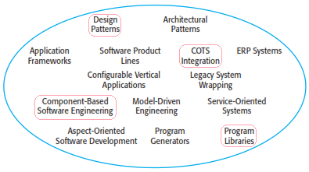
Reuse Definition & Prospect
Software reuse, is the use of existing software, or software knowledge,
to build new software. [Frakes, W.B. & Kyo Kang, (2005) ]
Prospect
[Ian Sommerville, Software Eng. 9th Ed.]

Slide 4
Benefits of Software Reuse can be taken to the EXTREME with Cloud Computing
Accelerated Development & Productivity
Increased Reliability & Quality
Reduce Risk (cost wise!)
Effective Use of Specialist
Standard Compliance
Saving Time & Money
[Ian Sommerville, Software Eng.9th Ed.]

Slide 5
Questions? About Known Problems of Reuse
• Increased maintenance costs and Lack of tool support (Not anymore!)
• Not-invented-here syndrome (Not anymore!)
• Creating and maintaining a library of reusable components can be expensive (Not anymore!)
• Finding, understanding and adapting reusable components can be a difficult task (A challenge!)
[Ian Sommerville, Software Eng. 9th Ed.]

Slide 6
Who Practices Software Reuse?
Worldwide:
In Jordan: ESTARTA, Eskidenia Software Solutions
In Europe: The European Space Agency, The European Strategic Program for Research in IT, Siemens, etc.
In Japan: Hitachi, Fujitsu, NEC, NTT, Toshiba, etc.
In the US Gov.: Army Reuse Center, Air Force, Idaho National Engineering Lab and DoD, etc.
US Private: AT&T, GTE, IBM, HP, Microsoft, Raytheon, etc.

Slide 7
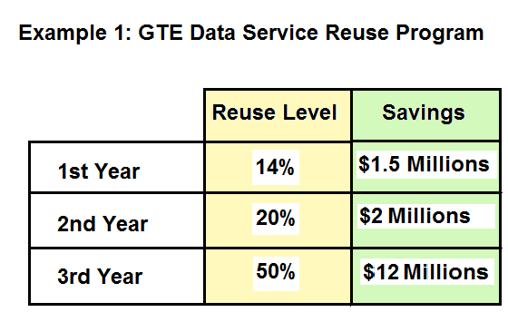
Figure-1

Slide 8
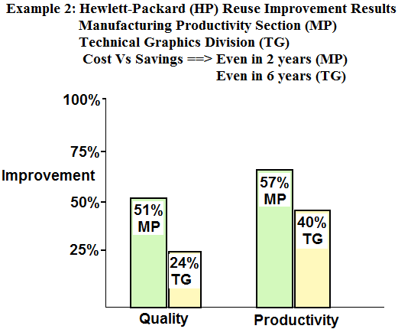
Figure-2

Slide 9
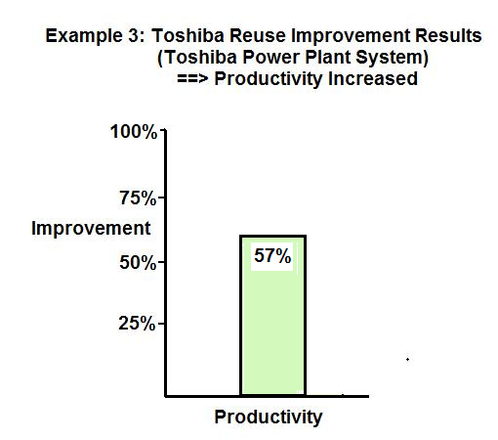
Figure-3

Slide 10
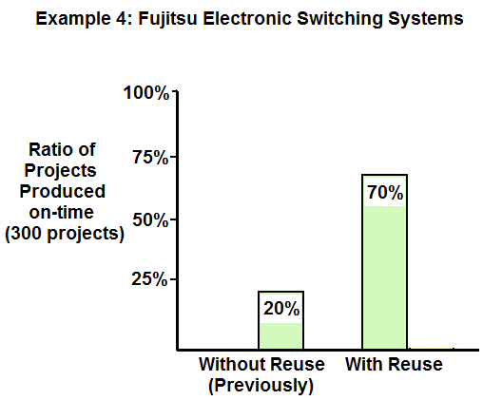
Figure-4

Slide 11
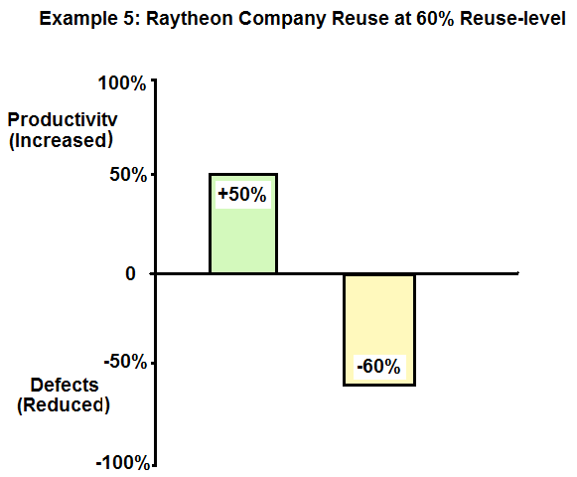
Figure-5

Slide 12
About Software Reuse
Design for Reuse:
Design with Reuse:

Slide 13
Design for Reuse
➔Designing & building components to be reusable.
Issues:
Size: There are two possibilities:
(i). Large Assets (say Project-based)
Assessment: High reuse% but limited area of apps.
(ii). Small-size Components (say Object Class)
➔ Assessment: low reuse% but wider area of apps.

Slide 14
Design for Reuse (cont.)
Issues (cont.) :
Size
Application Domain
➔ Functional aspect/behavior differs from one
application domain to another. However, application domains do have something in common
(GUI is a good guess!)

Slide 15
Design for Reuse (cont.)
Issues (cont.) :
Size
Application Domain
Programming Language
What is the best programming language?
➔ Developers are advised that the best programming language is the one you know best!

Slide 16
Most popular server-side programming languages with usage change

Slide 17
Design for Reuse (cont.)
Issues (cont.) :
Size
Application Domain
Programming Language
Other factors may impact the design process such as effort and productivity

Slide 18
Design with Reuse
➔Reusing existing components in designing
a new system.
Issues:
Successful reuse depends on how easily a user can deploy such components in a system.
[Reghu Anguswamy and William B. Frakes, 2011], Software Reuse Lab, Virginia Tech., VA 22043, USA.

Slide 19
Design with Reuse (cont.)
Issues (cont.):
➔ Factors affecting the ease of use:
Size of reusable components
Reuse design principle followed to build the reusable component
Human factor (experience of users in programming and reuse)
Testing factor (whether testing a component makes it easier to reuse or not!)
[Reghu Anguswamy and William B. Frakes, 2011], Software Reuse Lab, Virginia Tech., VA 22043, USA.

Slide 20
Potential Research (Idea #1)
How can we design, organize, classify and store reusable components so it is easy for developers to find the appropriate ones for a given system’s requirements?
What factors to consider?

Slide 21
Criteria Analysis…
Should we design reusable components that are independent from application domain?
➔ If Yes; Commonality is the player!
➔ If No; Classification is the player!
Should we design reusable components that are independent from programming languages?
➔ If Yes; Design Patterns is the player!
➔ If No; Choice of Prog. Lang. is the player!

Slide 22
Cloud Computing (CC)
Definition
CC is an emerging paradigm of data and computation sharing over a scalable network of nodes (the “cloud”); these nodes include clients, data centers, and Web services (Mirzaei, 2009), or
Internet-based services and resources that are delivered to clients on-demand from a service provider (Beatty, 2009).

Slide 23
Advantages of CC
Reduce the technological gap… (Duggan, 2010)
Improved end-user productivity…(Mirzaei, 2009)
Businesses have access to technology but at a lower cost… (Schluting, 2010)
Usage-based pricing…(Beatty, 2009)
➔ Problems of CC are mainly associated with:
- Lack of stability,
- Lack of customization ability, and
- Security concerns (Schluting, 2010)

Slide 24
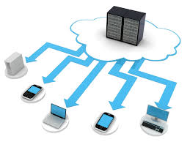
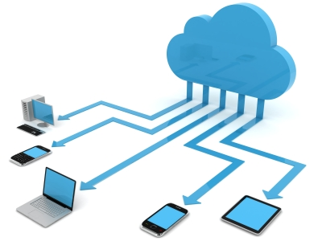
Types of Clouds
Public,
Private,
Hybrid (public/private),
Community,
Combined and
Inter cloud (cloud of clouds)

Slide 25
Public Cloud
Provided by companies such as Microsoft, Google, or Apple, where we:
Store documents remotely on their servers, or
Use a service like Flickr to store & share photos.

Slide 26
Private Cloud
Companies wanted to provide employees secure access to files from any device anywhere. Since it’s private, it’s secure and the public does not have access to it.

Slide 27
CC Service Delivery Models
Software as a Service (SaaS)
Provider facilitates the clients with licensed applications running on a cloud infrastructure through a thin client interface such as a web browser over the internet on pay-per-use pricing pattern.
Examples: Zoho Suite, Apple’s MobileMe
and Google Docs.
http://www.cisco.com/web/strategy/docs/gov/CiscoCloudComputing_WP.pdf

Slide 28
CC Service Delivery Models (cont.)
Platform as a Service (PaaS)
Provider facilitates the clients with the programming language platforms and software such as, but not limited to, Java, Python or .Net, to deploy their created or acquired applications on the cloud infrastructure over the internet with Application Program Interfaces (APIs) or website portals.
Example: MS-Azure and Google App Engine
and Force.com.
[Kai Hwang, et al (2009)]

Slide 29
CC Service Delivery Models (cont.)
Infrastructure as a Service (IaaS)
Provider facilitates clients’ capability of provision processing, storage, networks and other fundamental computing resources where the clients are able to deploy and run arbitrary software that includes operating systems and applications. IaaS delivers a platform virtualization environment as a service.
Examples: Amazon EC2 and S3, Sun Microsystems
and Dropbox.
[Jianfeng Yang and Zhibin Chen, (2010)]

Slide 30
And More,,,
Integration as a Service (IGaaS)
Business Process as a Service (BPaaS)
Desktop as a Service (DaaS)
Testing as a Service (TaaS)
Management as a Service (MaaS)
Security as a Service (SecaaS)
Everything as a Service (XaaS)
________________________________

Slide 31
Potential Research (Idea #2) What about Reuse as a Service (RaaS)?
With Reuse as a Service:
Developers can manipulate reusable components on the clouds as follows:
Download to use as is! and/or to customize then use
Build and upload new ones and/or modify existing ones.
Here is a vision:
Framework for a Cloud Warehouse Associated with Domain-based Data Marts of Designed Reusable Components

Slide 32
Enhancing Existing Research (Idea #3)
Testing as a Service (TaaS)!
What about building a hierarchy of reusable components?
In OO it will be a hierarchy of object classes structured top-down based on ‘inheritance’ feature with a dynamic evaluation according to usage statistics.

Slide 33
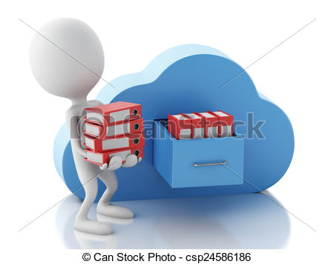
Clouds were born to be reused! With the cloud paradigm, I believe that there are many potential ideas to improve and expand software reuse

Slide 34
Thank You
Any Questions?

